Slide 1


Intermediate Python
Pre-trained Models & Computer Vision

Slide 2
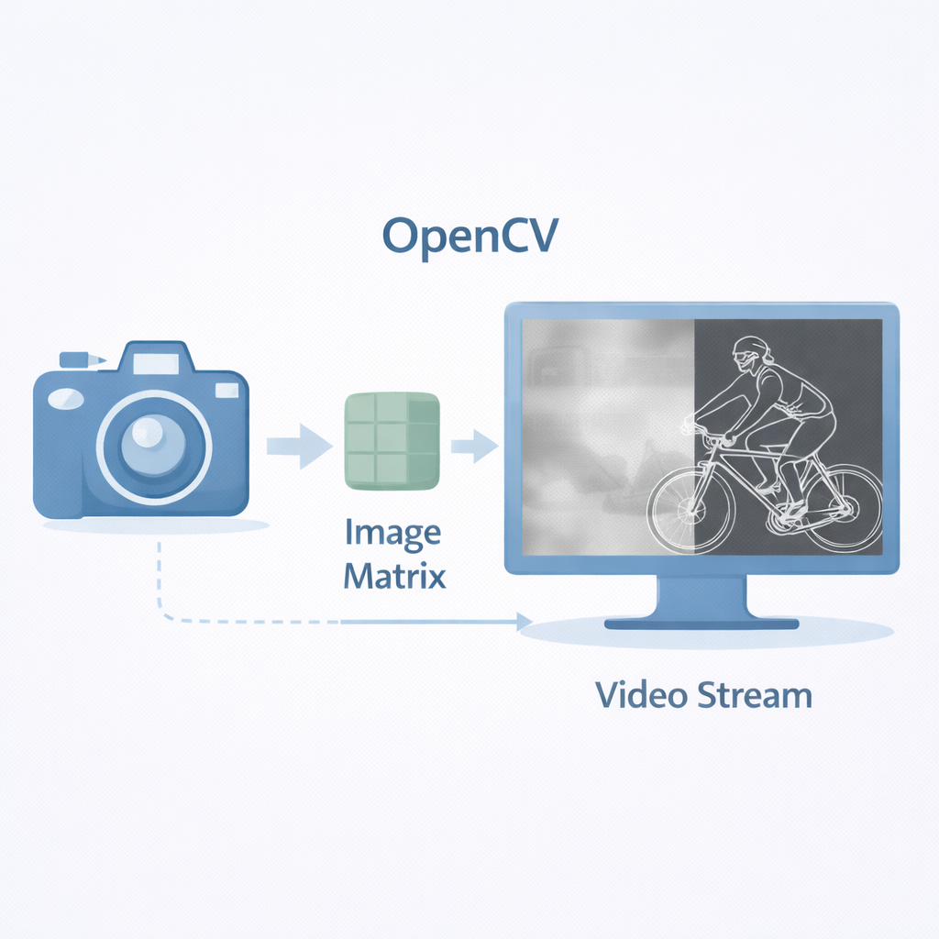
OpenCV Basics
OpenCV is a powerful Python library for computer vision and image processing.
OpenCV = Open Source Computer Vision library
Used for image & video processing
Works with NumPy arrays (images = matrices)
Supports real-time applications
Can detect faces, objects, edges, motion
Widely used in AI & robotics
Notes:
Explain that OpenCV treats images as NumPy arrays. Every image is essentially a matrix of pixel values. Most AI vision pipelines begin with preprocessing using OpenCV.

Slide 3
Example Code
import cv2
# Load image
img = cv2.imread("photo.jpg")
# Convert to grayscale
gray = cv2.cvtColor(img, cv2.COLOR_BGR2GRAY)
cv2.imshow("Grayscale", gray)
cv2.waitKey(0)
cv2.destroyAllWindows()

Slide 4
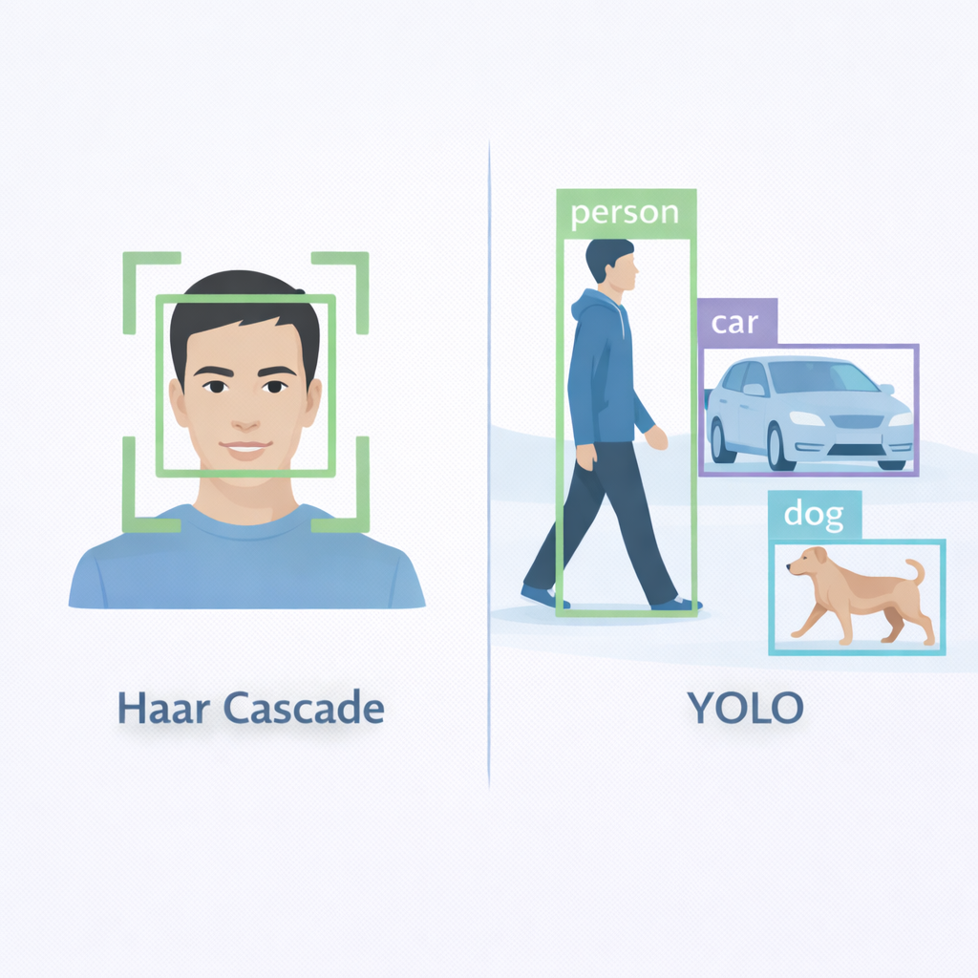
Haar Cascade & YOLO
Pre-trained models allow object detection without training from scratch.
Haar Cascade → Classical CV-based face detection
Fast and lightweight
Good for simple face detection tasks
YOLO (You Only Look Once) → Deep learning object detection
Detects multiple object types
More accurate but heavier
Notes:
Haar Cascade is older but fast. YOLO is modern deep learning-based detection. Choose based on performance needs and hardware constraints.

Slide 5
Haar Cascade Example
import cv2
face_cascade = cv2.CascadeClassifier(
cv2.data.haarcascades + "haarcascade_frontalface_default.xml"
)
img = cv2.imread("photo.jpg")
gray = cv2.cvtColor(img, cv2.COLOR_BGR2GRAY)
faces = face_cascade.detectMultiScale(gray, 1.3, 5)

Slide 6
Haar Cascade Example (2)
for (x, y, w, h) in faces:
cv2.rectangle(img, (x, y), (x+w, y+h), (0,255,0), 2)
cv2.imshow("Faces", img)
cv2.waitKey(0)
cv2.destroyAllWindows()

Slide 7
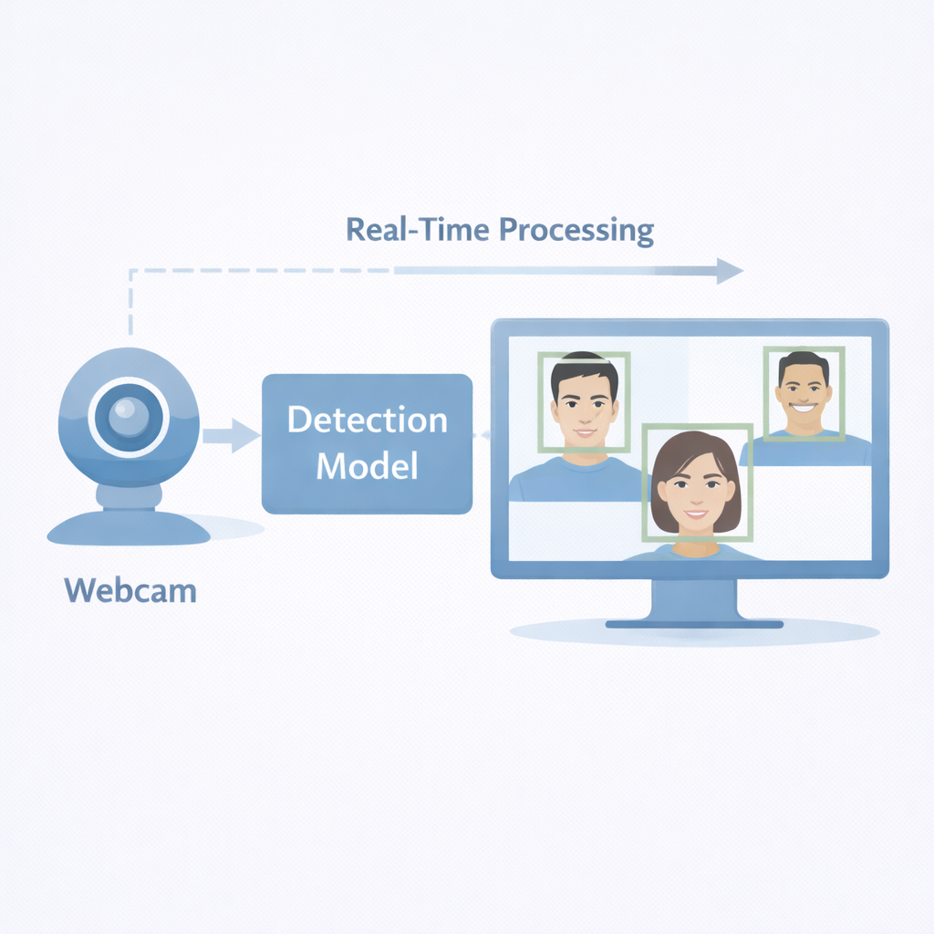
Real-Time Face Detection
Real-time detection uses live video streams for instant AI processing.
Uses webcam via cv2.VideoCapture()
Frame-by-frame processing
Convert each frame to grayscale
Detect faces continuously
Draw bounding boxes in real-time
Press key to stop loop
Notes:
Explain the loop structure:
Capture frame
Process frame
Detect faces
Display result
Repeat
This is how surveillance systems and attendance systems work.

Slide 8
Code Example
import cv2
face_cascade = cv2.CascadeClassifier(
cv2.data.haarcascades + "haarcascade_frontalface_default.xml"
)
cap = cv2.VideoCapture(0)
while True:
ret, frame = cap.read()
gray = cv2.cvtColor(frame, cv2.COLOR_BGR2GRAY)
)

Slide 9
Code Example (2)
faces = face_cascade.detectMultiScale(gray, 1.3, 5)
for (x, y, w, h) in faces:
cv2.rectangle(frame, (x, y), (x+w, y+h), (0,255,0), 2)
cv2.imshow("Real-Time Face Detection", frame)
if cv2.waitKey(1) & 0xFF == ord('q'):
break
cap.release()
cv2.destroyAllWindows(

Slide 10
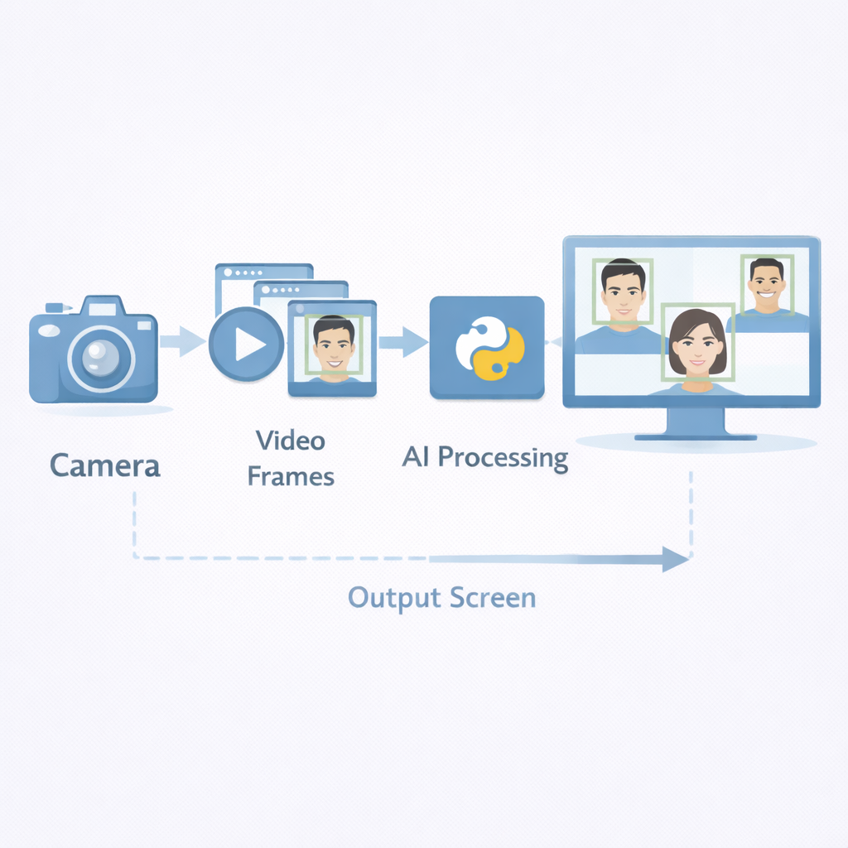
Video Capture Fundamentals
Video capture enables AI to process live camera feeds or recorded files.
cv2.VideoCapture(0) → Webcam
cv2.VideoCapture("video.mp4") → Video file
Frames are processed sequentially
FPS affects performance
Always release camera properly
Real-time systems require optimization
🖼 Image Prompt
🎤 Speaker Notes
🎯
Notes:
Emphasize:
Video is just many images per second
Real-time AI = process frames fast enough
Performance optimization matters

Slide 11
Session Summary
From static images to real-time AI vision.
OpenCV handles image/video processing
Haar Cascade for lightweight detection
YOLO for advanced object detection
Real-time face detection via webcam
Video capture enables live AI applications

